Slide 1

Exploring Information and Communication Technologies (TIC)
R.SLIMANI
A.MAKHLOUF
A.DEROUAS
R.SAADI
A.CERBAH
29.12.2023

Slide 2

SUMMARY
Introduction to TIC
Some statestics
Google services
Microsoft tools
Git and github
Other relevant technologies
Conclusion

Slide 3

Introduction to TIC
TIC encompasses diverse tools & systems revolutionizing information processing, communication, and utilization.
TIC has an integral role in daily life, businesses, education, global interactions.
TIC is a constantly evolving landscape , from cloud computing to collaboration tools and version control systems.
Their aim is to explore fundamental concepts, highlight significance in modern society.

Slide 4
Some statistics
Année | Percentage of internet connection
2011 | 35.9%
2013 | 39.8%
2015 | 44.6%
2017 | 48.9%
2019 | 52.5%
2021 | 59.6%
Table 1 : Percentage of internet connection during 2011-2021

Slide 5




Google services
Comprehensive suite: Gmail, Drive, Docs, Meet, Sheets, Maps, Photos, YouTube,etc.
Core Features:
Email communication (Gmail)
Cloud storage and file sharing (Drive)
Mapping and navigation (Maps)
Media sharing and streaming (YouTube)
Advantages:
Wide range of integrated services
User-friendly interface
Extensive functionality and accebility
Applications:
Personal use (communication, navigation, entertainment)
Business use (collaboration, data storage, marketing)

Slide 6




Microsoft tools
Includes: Word, Excel, PowerPoint, Outlook, Teams, etc.
Features:
Word processing, data analysis, presentations, email, collaboration
Advantages:
Familiar interface
Versatile functionality
Seamless integration
Applications:
Business, education, personal use

Slide 7


Git and Github
Git:
Version control system for tracking changes in code
Enable branching, merging, and collaborations among developers
Github:
Web-based platform for hosting Git repositories
Facilitates collaboration, code review, and project management
Advantages:
Git: Efficient code management and collaboration
Github: Centralized repository hosting and collaboration features
Applications:
Software development, version control, open-source contributions

Slide 8


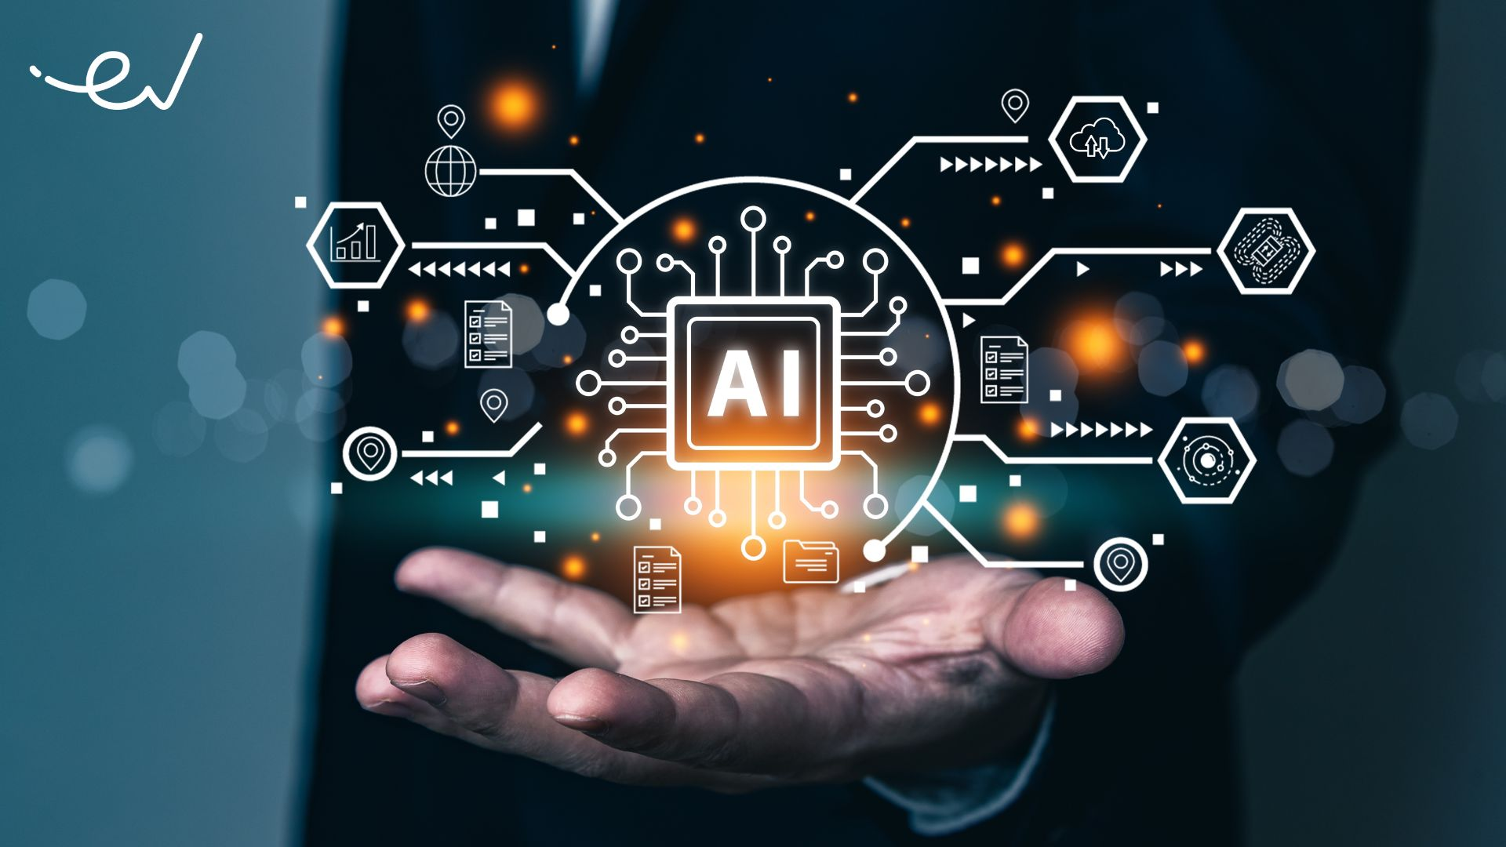


Other relevant technologies
Cloud computing: Remote data storage
Cybersecurity: Protection from digital threats
Artificial intelligence(AI): Machine learning
Internet of things(IoT): Connected devices
Blockchain: Secure transactions

Slide 9


Conclusion
TIC: Integral for modern operations
Google, Microsoft, Git, GitHub: Streamline work, collaboration
Key Technologies: Transforming industries
Future: Continued technological evolution
Thank you for your attention.

